Slide 1
Applying Common Core State Standards at the K-12 Academic Levels Using NXT LEGO® Robotics
2012 Research Experience for Undergraduates in Ocean, Marine, and Polar Science

Slide 2
Mathematics Team
Dezerae Little Derrick Jones
Saint Augustine’s College Mississippi Valley State University
Mentor: Dr. Darnell Johnson
Elizabeth City State University

Slide 3
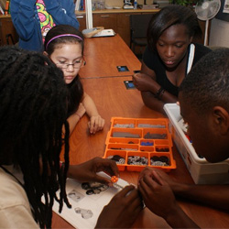
Overview
Abstract
Introduction
Methodology
Results
Conclusion
Future Research
Questions
Acknowledgements

Slide 4
Abstract
Common Core Standards includes critical content for all students in American education. Forty-eight of the fifty states have adopted the standards as of 2012. Previously, every state had its own set of academic standards and students in each state had been learning at different levels. In the new global economy, all students must be prepared to compete with students from around the world. Students are expected to develop deeper mastery of content and demonstrate what they know through writing and other projects. Changes to curriculum and instruction are more student-centered with greater focus on skills, abilities, and a shift towards more performance assessments. This research was designed to apply mathematical processes of the Common Core Standard in a lesson plan on the K-12 academic level: elementary, middle and high school. The team used NXT LEGO® robotics to teach various scientific, mathematical, and design concepts, through designing, building, and programming the robots at each level. The students’ received hands on experience with physics, mathematics, motion, environmental factors, and use problem solving in a collaborative group setting. The data was collected through observations.

Slide 5
Introduction
The North Carolina Standard Course of Study
Content Standards
Numbers and Operations
Algebra
Geometry
Measurement
Data Analysis and Probability
Notes:
The North Carolina Mathematics Standard Course of Study is organized in five strands or goals for K-12: Number and Operations, Measurements, Geometry, Data Analysis and Probability, and Algebra. These are the objectives for each goal in complexity at each grade level and throughout the high school courses. It is the framework upon which classroom instruction and assessment should be planned. It is the ultimate guide for textbook selections and the foundation of the North Carolina testing program. On June 2, 2010, North Carolina adopted the Common Core State Standards in K-12 Mathematics and K-12 English Language Arts released by the National Governors Association Center for Best Practices and the Council of Chief State School Officers.

Slide 6
What are the Common Core State Standards?
Aligned with college and work expectations
Focused and coherent
Include rigorous content and application of knowledge through high‐order skills
Build upon strengths and lessons of current state standards
Internationally benchmarked
Based on evidence and research
Texas and Alaska have not yet adopted the Standards*
Notes:
The Common Core State Standards Initiative is a state-led effort coordinated by the National Governors Association Center for Best Practices (NGA Center) and the Council of Chief State School Officers (CCSSO). The standards were developed in collaboration with teachers, school administrators, and experts, to provide a clear and consistent framework to prepare our children for college and the workforce. The Common Core Standard is designed to build upon the most advanced current thinking about preparing all students for success in college and their careers. The standards are as follows:

Slide 7
Importance of Common Core
Academic standards
Global competition
Notes:
1. The Common Core State Standards will provide more stability for the mobile student. In order to close the achievement gap once and for all we need consistency with learning targets for each grade level. Clear expectations across each county, state and nation will help create stability for students who move often due to economic and personal reasons.
2. The Common Core State Standards will provide students with the necessary skills to access higher education and to compete globally in the workforce. The Common Core is a vehicle that will assist educators in creating quality and fair skills-based instruction to all students. The 21st century skills embedded in the Common Core will pave the way for students to think, reflect, analyze, influence, evaluate, and communicate; in other words, become an individual who will lead in the 21st century global society. Look around your classroom. Who will be the leaders of tomorrow?
3. The Common Core State Standards will enhance teacher collaboration across the nation. When teachers across the nation are using the same standards and common language, collaboration becomes more meaningful. Professional development at conferences, professional organizations and across networks will be more powerful than ever. When teachers share best practice, students benefit.
http://core4all.wordpress.com/2010/10/01/top-3-benefits-of-the-common-core-state-standards-and-a-thank-you/

Slide 8
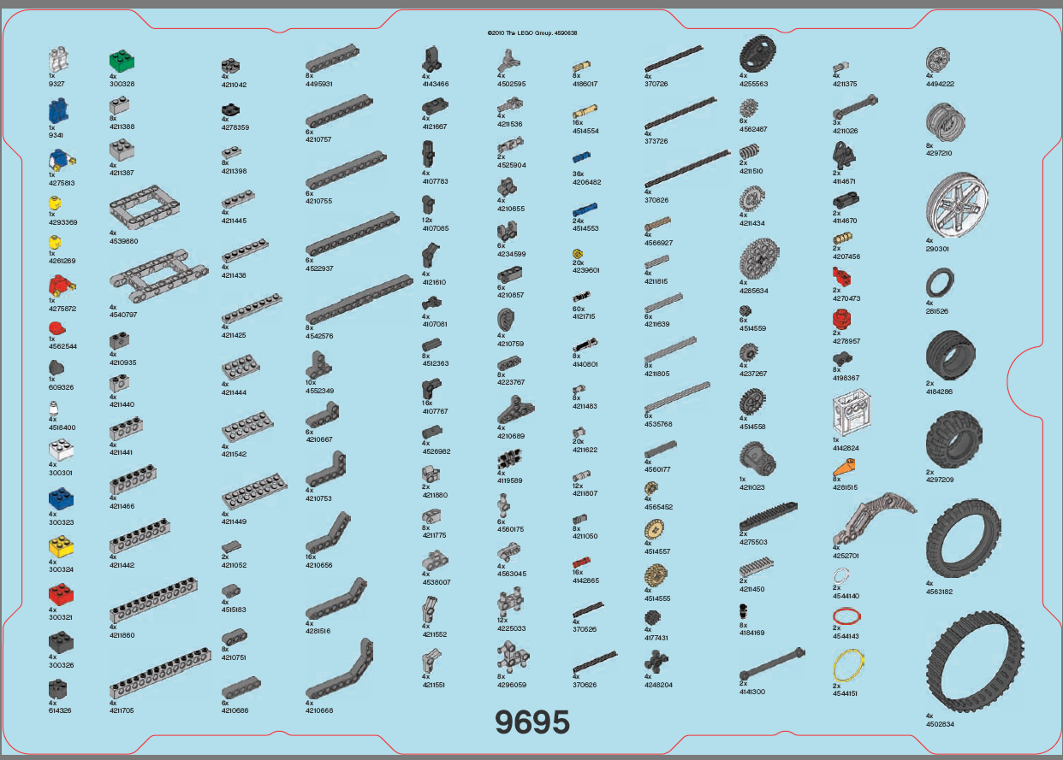
Course Plan
I.C Norcom High School
NXT Programming Software
NXT Robot Assembling
NXT Robot Programming
Notes:
Before working with the students in the CReSIS Middle School Program, the mathematics education research team studied the Common Core Standard for North Carolina, NXT LEGO® Robotics, and the 5E lesson plan. Our process started by visiting teachers at I.C. Norcom High School in Portsmouth, Virginia; the team was introduced to two teachers, Mr. Daron Moore and Mrs. Veronica Williams. Mr. Daron Moore was a Physics teacher for 9 years. He teaches physics and as well as preparing the school’s robotics team for competitions. His team recently placed 1st in the 2012 regional competition. Mr. Moore gave the math team a brief history of teaching different levels of students and how to effectively instruct them. Mrs. Veronica Williams was a mathematics teacher at I.C. Norcom. She has been a mathematics teacher for 20 years, she is currently teaching Algebra II and I. She talked about the effectiveness of the 5E lesson plan.
Later the math team researched NXT LEGO® Robotics using various sources such as the LEGO® Robotics websites, YouTube videos, and the NXT owner’s manual. LEGO® Robots kit came with the programming software; the software is an object oriented programming guide. Object oriented programming makes it less challenging to maintain and modify existing code as new objects can be created with small differences to existing ones. [2] The math team repetitively assembled and programmed the robots in order to master the process and concept of constructing the robot. An obstacle course was built to test and debug the robots to simulate the task assigned for student grade level grouping for P-12.

Slide 9
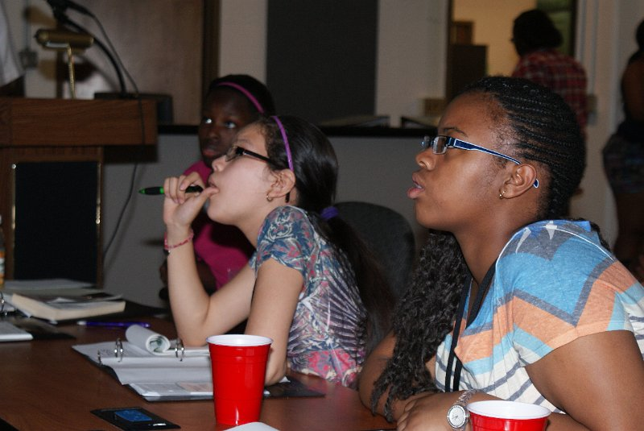
The 5E Lesson Plan
The math team used 5E lesson plans for each student level: elementary school, middle school, and high school.
Engagement
Exploration
Explanation
Elaboration
Evaluation

Slide 10
Methodology
Introduction of Robotics
Establishment of Teams
Assembling of Robots
Programming of Robots
Obstacle Course
Acknowledgement of Team Winners
Notes:
The purpose for the engagement stage is to peak student interest and get them personally involved in the lesson, while pre-assessing prior understanding.
The students became familiar with the project at hand and the learners shared their prior knowledge with robots and programming software. The team asked the students a series of questions such as “What do you know about robots?” “Have you ever assembled a LEGO® robot?” and “have you ever programmed a robot or anything pertaining to robots?”
Exploration
The purpose for the exploration stage is to get students involved in the topic, providing them with an opportunity to build their own understanding. Through self-designed or guided exploration students make hypotheses, test their own predictions, and draw their own conclusions.
The team dissected the robots, telling what each part does. The team constructed a PowerPoint and the LEGO® tool chart to aid in this step. Afterwards, the students identified instruments and discussed how the robots function.
Explantion
The purpose for the explanation stage is to provide students with an opportunity to communicate what they have learned so far and figure out what it means. Explain is the stage at which learners begin to communicate what they have learned.
Learners investigated the various NXT robots and a video of higher-level robots used by NASA to explore areas. Afterwards, the students shared what they’ve learned and understand about robotics.
Elaboration
The purpose for the elaboration stage is to allow students to use their new knowledge while continuing to explore its implications. At this stage students expand on the concepts they have learned, make connections to other related concepts, and apply their understandings to the world around them in new ways.
Learners applied their knowledge of robots and programming. The students were divided into two groups; each group was to build, program, and test the robot while being timed. There were no set time on the teams; therefore there was no pressure on the groups to configure their workings.
Evaluation
The purpose for the evaluation stage is for both students and teachers to determine how much learning and understanding has taken place. Evaluate, the final "E", is an on-going diagnostic process that allows the teacher to determine if the learner has attained understanding of concepts and knowledge
Learners demonstrated their understanding of robotics by implementing skills obtained by building, programming, and testing the robot on a course built by the instructors. The groups debugged the errors found in their program after navigation of the course.

Slide 11
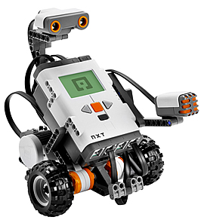
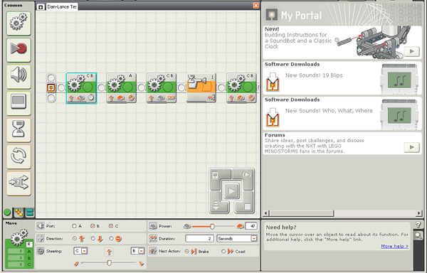
Observations
Assembling Observation
Programming and Debugging Observation
Notes:
Assembling Observation
The REU mathematics team was the facilitators over the groups. The team answered questions asks by the groups, help mend problems in the build after the students finished building, along with facilitating the testing and debugging phase. Some areas the groups had problems with were cooperation and understanding. In the Middle School section, there were problems with students getting involved; some students took control while others watched. To fix the problem, the facilitators spontaneously started a modern day “assembly line”. The facilitators assigned each group member a page to assemble. The alternative enhanced the cooperativeness and dependency on one another. Each group member had to pay attention to the “assembly line” in order to know what portions needed to be done when it is their turn to assemble.
Programming & Debugging Observation
When the assembling was complete, the mathematic team gave each group an overview of the obstacle course and a demonstration of how their robots should maneuver through the course. To make the demonstration easier, the team built and programmed a prototype robot to perform on the course. After the overview, the groups programmed the robots. The software used was part of the NXT LEGO® Robotics kit; it is an object oriented programming software similar to Alice™ and the C++ computer language. The groups used basic mathematics and physics to figure their way around the obstacle course. The groups configured the robots to perform specific tasks needed to operate efficiently. The groups programmed the robots to turn at 90º angles, the direction to turn, and when to turn. The programming technique was based on timing; each programming piece needed the correct timing to function properly. If the timing was off, the robot could’ve done thing such as run astray, crash into objects, and even fail to reach the finish line. There was no group to get the programming right on the first try. It took consistent programming in order to perfect the program. Each team tested and debugged the robots numerous times.

Slide 12
Results

Slide 13
Assembling & Programming Robots

Slide 14
Conclusion
Focus of research project
Overall goal of research project
Notes:
The main focus of this research project was to examine the principles of the Common Core Standard taken by the state of North Carolina while using the 5E learning style and inquiry based learning. The overall goal of this project was to test the effectiveness of this Standard as it is implemented in the classroom setting. Observations were done on the students to perceive how the students learned and responded to the Standard. The teaching strategies used assessed the students’ independent learning abilities, enhanced thinking skills, and produced cooperation in the group setting. More studies needs to be done to on this project to collect more data to get a clear analysis of the effectiveness of The Common Core Standard.

Slide 15
Future Work
Saturday Academy for K-12 Student Groups-1 semester long
Use a ratio of 3:1 students to robots
Workshops for pre-service teachers
Workshops for elementary & middle school teachers
Notes:
This study was completed during several one-hour sessions for each grade level of K-12 student groups. The research further determined the success of the study but a longer time frame of one semester is strongly recommended. A time frame of at least eight three hour sessions on Saturday workshops or academies would allow in depth instructional time with robotics. The amount of data needed to measure enhanced student learning would be acquired as well.
A second recommendation would be the availability of at least one NXT LEGO® Robot per every two students. There were on average four students to a robotics kit that compromised equal time in robot assembly for each student. After repeatedly demonstrating the project, more robots were required to obtain a student to robot ratio of 3:1. A ratio of 2:1 would be preferred. Installation of the NXT LEGO® Robotics software on laptop computers would be required for instruction purposes. The mathematics team experienced problems finding a definite location to teach the class, assemble and program the robots.
The final recommendation for future research would include a work session for per-service educators as well as teachers at the elementary and middle levels.

Slide 16
QUESTIONS?

Slide 17
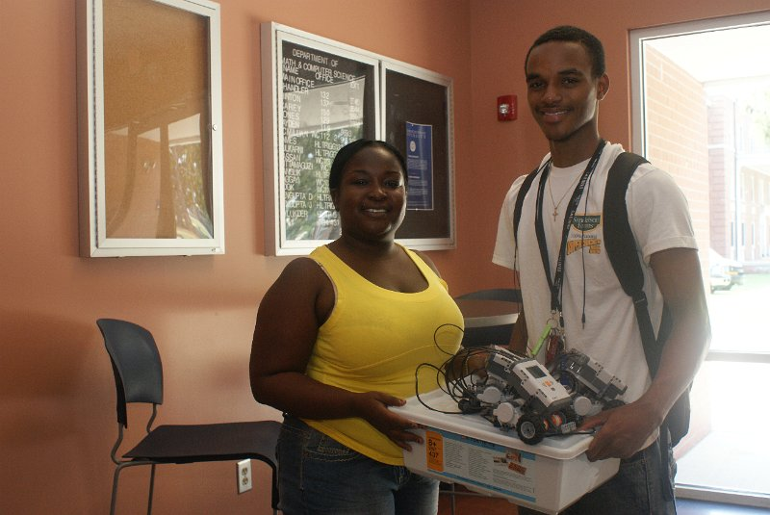
Acknowledgements
The 2012 REU Mathematics Team would like to thank
CERSER Principal Investigator, Dr. Linda B. Hayden.
I. C. Norcom High School teachers; Mr. Daron Moore and Mrs. Veronica Williams.
Dr. Darnell Johnson
Mr. Je'aime Powell
Notes:
The 2012 REU Mathematics Team would like to thank CERSER Principal Investigator, Dr. Linda B. Hayden, for making the Research Experience for Undergraduate in Ocean, Marine, and Polar Science possible. The team would also like to give a special thanks to I. C. Norcom High School teachers; Mr. Daron Moore and Mrs. Veronica Williams for their support of the project. The team would also like to thank Dr. Darnell Johnson for being the mentor and a very special thanks to Mr. Je'aime Powell for constantly installing the NXT LEGO® Robotics software.

